Slide 1
Monday, Sept. 19, 2016
Notebook Time:
Take a close look at Mindy Kaling’s “Heart Map”, which replaced a traditional author bio in her recent book Why Not Me. Notice how she uses details to make this graphic entertaining and full of authorial voice. Then, make your own “Heart Map” in your notebook.

Slide 2
Tone in Images
Kanye West

Slide 3
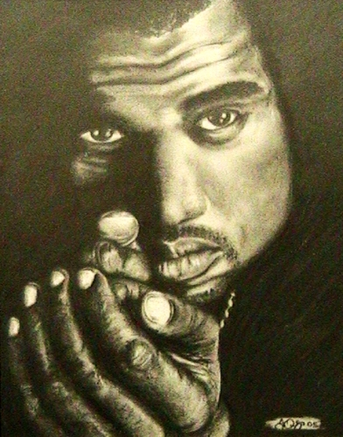
J. Egan
Kanye West
Portrait Drawing

Slide 4
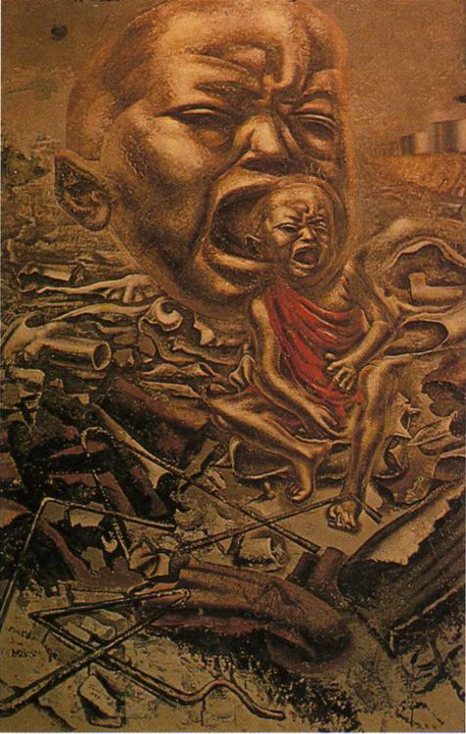
David Alfaro Siqueiros
The Echo of the Scream

Slide 5
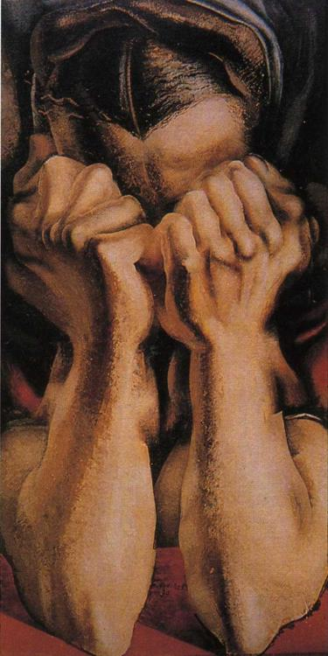
David Alfaro Siqueiros
The Sob

Slide 6
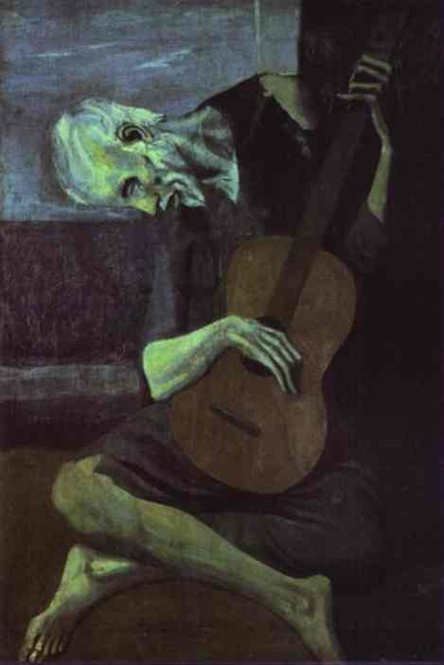
Pablo Picasso
The Old Guitarist

Slide 7
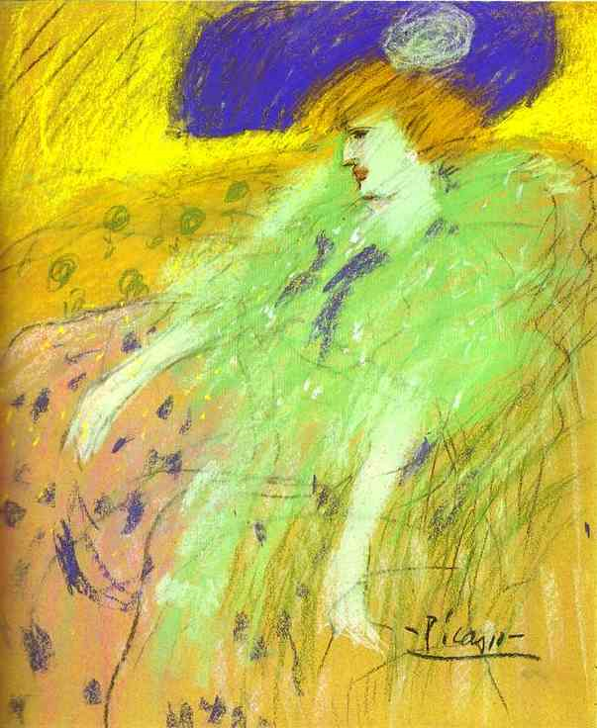
Pablo Picasso
Woman in a Blue Hat

Slide 8
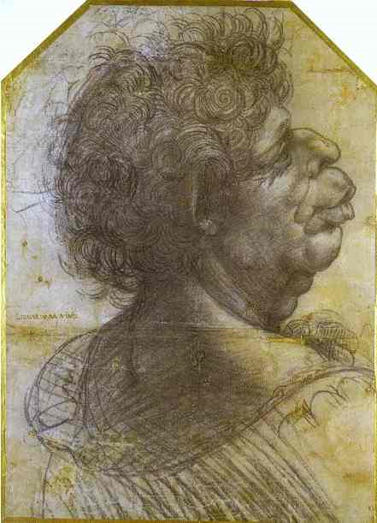
Leonardo da Vinci
Grotesque Portrait Study of Man

Slide 9
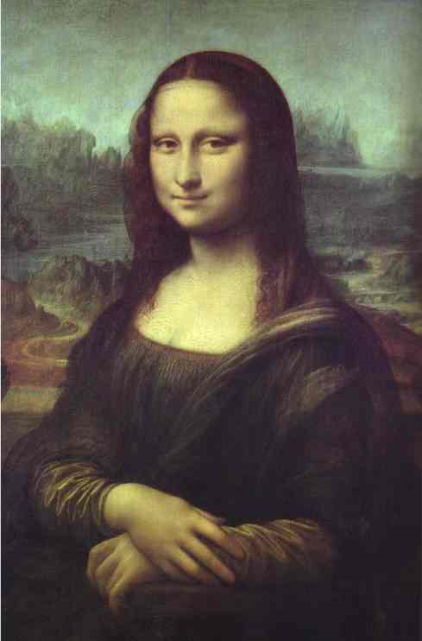
Leonardo da Vinci
Mona Lisa

Slide 10
Nina Berman
Pfc. Alan Jermaine Lewis, 23

Slide 11
Lynda Churilla
Soldier in the Iraq War
Fighting Back!

Slide 12
OPTIC Strategy
OPTIC allows us to go deeper into our analysis of an image
O = Overview: What is happening in the picture? Summarize the “action” of the visual without analyzing its meaning yet.
P = Parts of the picture: Break the picture down into sections. Describe the placement of objects on the picture. Name everything that you see.
T = Title: What does the title tell you about the picture? How much does it add to what you understand or do not understand about the picture? If there is no title, make one up.
I = Interrelationships: Analyze the relationships in the picture. How do objects or people relate to each other in the picture? What clues to the message or argument are these relationships giving you? What seems to be the most important “relationship” in the picture?
C = Conclusion: Draw a conclusion to the meaning or message of the picture based on what you have viewed and discussed as a group. Essentially, what is the argument the author is trying to convey?

